Slide 1

Sequence to sequence models
Refinements to beam search
deeplearning.ai

Slide 2
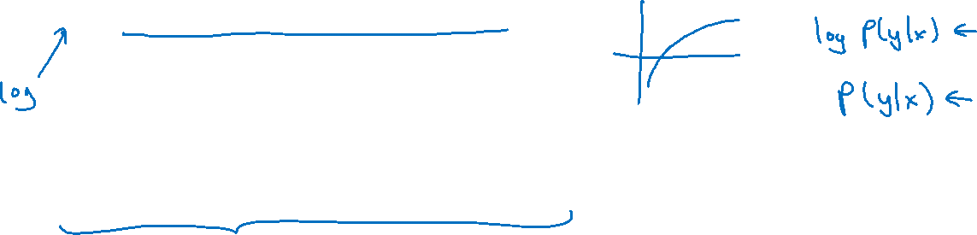
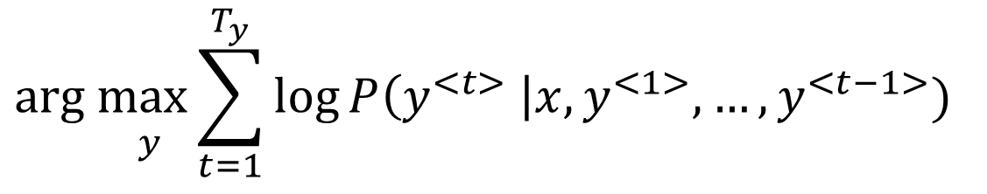
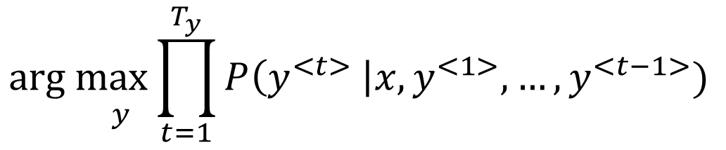
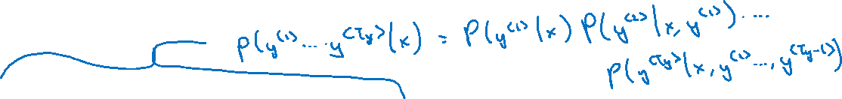
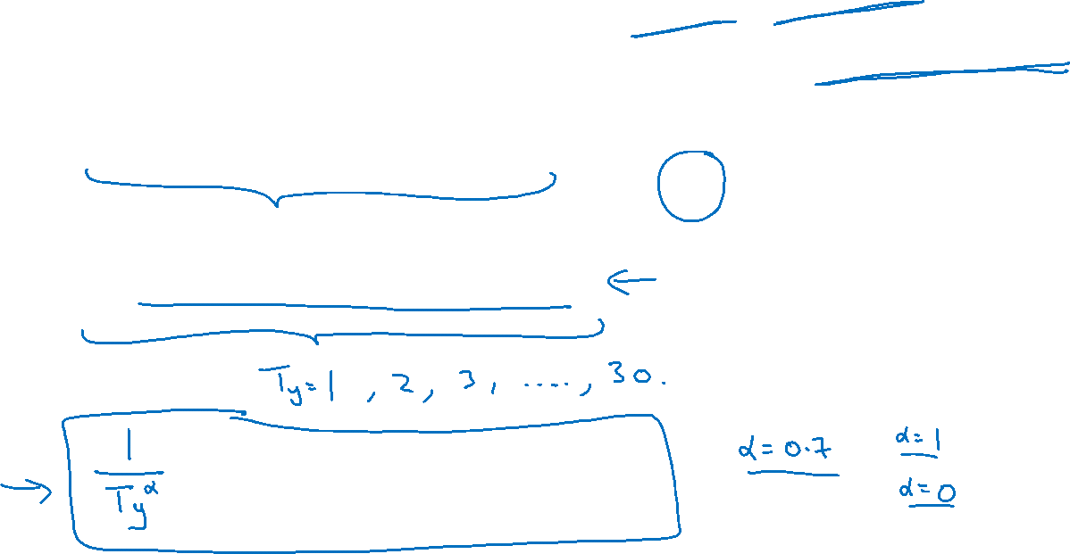
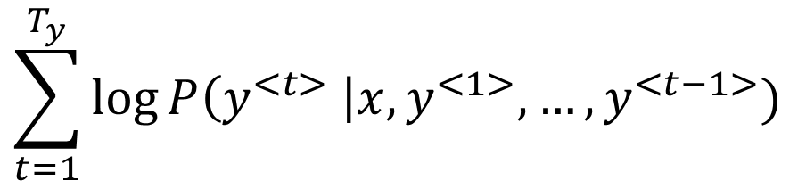
Length normalization
$${\underset{ y}{arg max}{\prod_{t=1}^{T_{y}}{P\left(y^{<t>} \right|x,y^{<1>},…,y^{<t−1>})}}}_{ }$$
$${\underset{ y}{arg max}{\sum_{t=1}^{T_{y}}{\log{P\left(y^{<t>} \right|x,y^{<1>},…,y^{<t−1>}) }}}}_{ }^{ }$$
$$\sum_{t=1}^{T_{y}}{\log{P\left(y^{<t>} \right|x,y^{<1>},…,y^{<t−1>}) }}$$

Slide 3
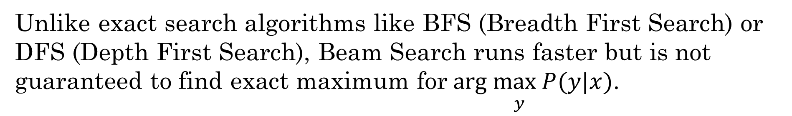
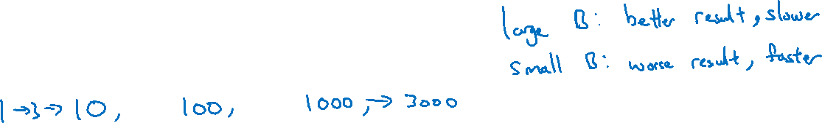
Beam search discussion
Beam width B?
Unlike exact search algorithms like BFS (Breadth First Search) or DFS (Depth First Search), Beam Search runs faster but is not guaranteed to find exact maximum for$\underset{ y}{arg max} P(y|x)$.

